Slide 1




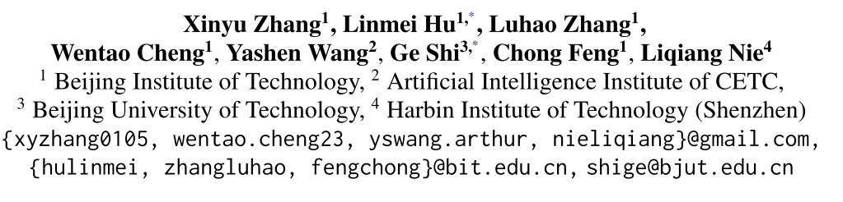
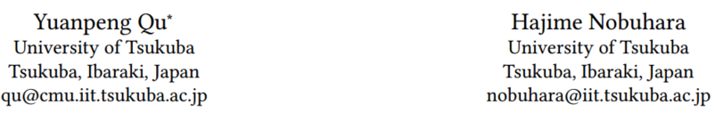





ATAI
Advanced Technique of Artificial Intelligence
ATAI
ChongqingUniversity _{AdvancedTechniqueof}
of Technology Artificial Intelligence
Chongqing University of
Technology
Chongqing University ^{ATAI}
_{of Technology} Advanced Techniqueof
Artificial Intelligence
Chongqing University of Technology
Chongqing University of Technology
Bi-Tuning with Collaborative Information for Controllable LLM-based Sequential Recommendation
Code : https://anonymous.4open.science/r/Laser-main-B1A5
—— ACL’2025
2025.9.29. • ChongQing
Reported by YaoYao Zhang
1

Slide 2
ATAI
Advanced Technique of Artificial Intelligence
ATAI
ChongqingUniversity _{AdvancedTechniqueof}
of Technology Artificial Intelligence
Chongqing University of
Technology
Chongqing University ^{ATAI}
_{of Technology} Advanced Techniqueof
Artificial Intelligence
Chongqing University of Technology
Chongqing University of Technology
Motivation
i) LLM-based recommendation systems primarily rely on text semantics, inherently overlooking collaborative signals.
ii) Existing LLM-based recommendation models are typically trained with next-token prediction loss to generate recommendation lists token by token, which easily leads to domain-specific formatting errors.

Slide 3
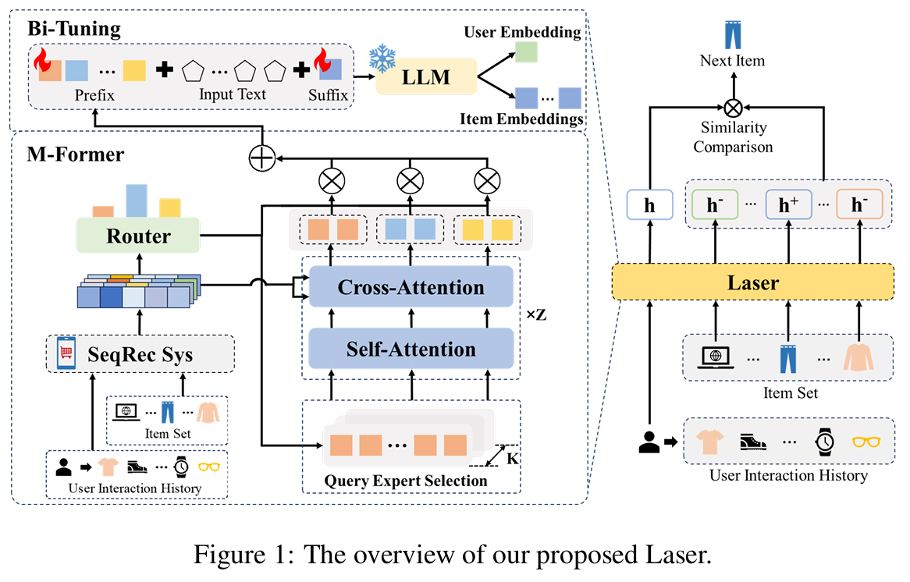
ATAI
Advanced Technique of Artificial Intelligence
ATAI
ChongqingUniversity _{AdvancedTechniqueof}
of Technology Artificial Intelligence
Chongqing University of
Technology
Chongqing University ^{ATAI}
_{of Technology} Advanced Techniqueof
Artificial Intelligence
Chongqing University of Technology
Chongqing University of Technology

Slide 4
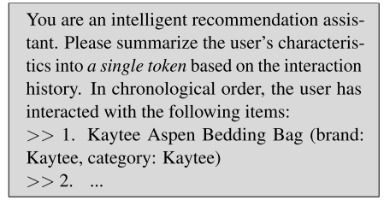
ATAI
Advanced Technique of Artificial Intelligence
ATAI
ChongqingUniversity _{AdvancedTechniqueof}
of Technology Artificial Intelligence
Chongqing University of
Technology
Chongqing University ^{ATAI}
_{of Technology} Advanced Techniqueof
Artificial Intelligence
Chongqing University of Technology
Chongqing University of Technology

Slide 5


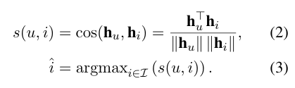



ATAI
Advanced Technique of Artificial Intelligence
ATAI
ChongqingUniversity _{AdvancedTechniqueof}
of Technology Artificial Intelligence
Chongqing University of
Technology
Chongqing University ^{ATAI}
_{of Technology} Advanced Techniqueof
Artificial Intelligence
Chongqing University of Technology
Chongqing University of Technology
Method

Slide 6
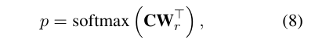


ATAI
Advanced Technique of Artificial Intelligence
ATAI
ChongqingUniversity _{AdvancedTechniqueof}
of Technology Artificial Intelligence
Chongqing University of
Technology
Chongqing University ^{ATAI}
_{of Technology} Advanced Techniqueof
Artificial Intelligence
Method
Chongqing University of Technology
Chongqing University of Technology

Slide 7
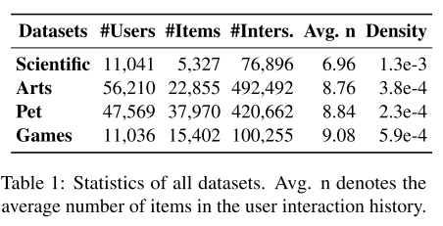
ATAI
Advanced Technique of Artificial Intelligence
ATAI
ChongqingUniversity _{AdvancedTechniqueof}
of Technology Artificial Intelligence
Chongqing University of
Technology
Chongqing University ^{ATAI}
_{of Technology} Advanced Techniqueof
Artificial Intelligence
Method
Chongqing University of Technology
Chongqing University of Technology

Slide 8
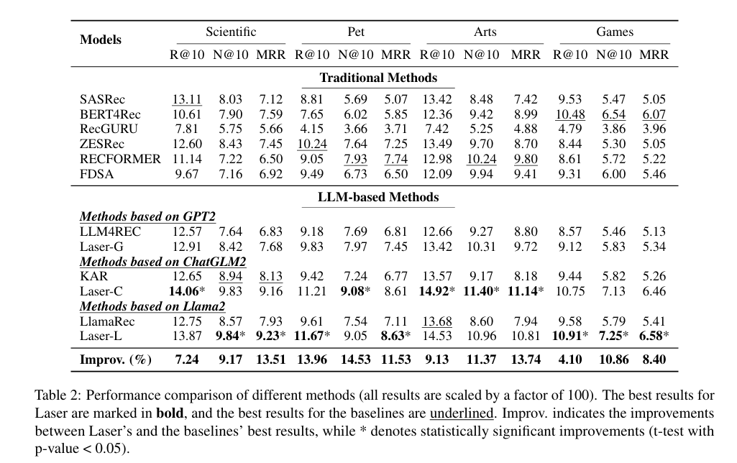
ATAI
Advanced Technique of Artificial Intelligence
ATAI
ChongqingUniversity _{AdvancedTechniqueof}
of Technology Artificial Intelligence
Chongqing University of
Technology
Chongqing University ^{ATAI}
_{of Technology} Advanced Techniqueof
Artificial Intelligence
Method
Chongqing University of Technology
Chongqing University of Technology

Slide 9
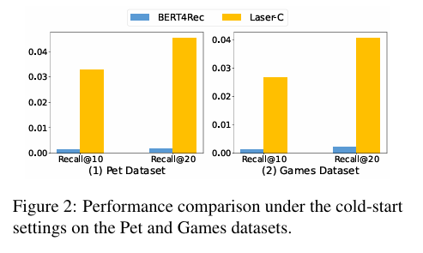
ATAI
Advanced Technique of Artificial Intelligence
ATAI
ChongqingUniversity _{AdvancedTechniqueof}
of Technology Artificial Intelligence
Chongqing University of
Technology
Chongqing University ^{ATAI}
_{of Technology} Advanced Techniqueof
Artificial Intelligence
Method
Chongqing University of Technology
Chongqing University of Technology

Slide 10
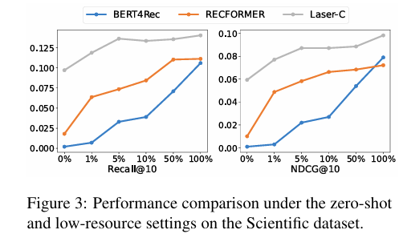
ATAI
Advanced Technique of Artificial Intelligence
ATAI
ChongqingUniversity _{AdvancedTechniqueof}
of Technology Artificial Intelligence
Chongqing University of
Technology
Chongqing University ^{ATAI}
_{of Technology} Advanced Techniqueof
Artificial Intelligence
Method
Chongqing University of Technology
Chongqing University of Technology

Slide 11
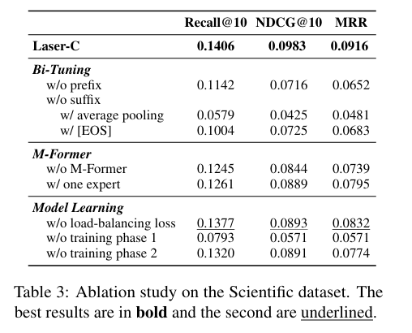
ATAI
Advanced Technique of Artificial Intelligence
ATAI
ChongqingUniversity _{AdvancedTechniqueof}
of Technology Artificial Intelligence
Chongqing University of
Technology
Chongqing University ^{ATAI}
_{of Technology} Advanced Techniqueof
Artificial Intelligence
Chongqing University of Technology
Experiments
Chongqing University of Technology

Slide 12
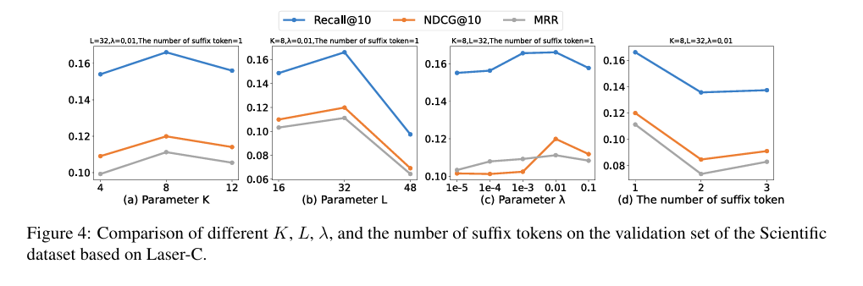
ATAI
Advanced Technique of Artificial Intelligence
ATAI
ChongqingUniversity _{AdvancedTechniqueof}
of Technology Artificial Intelligence
Chongqing University of
Technology
Chongqing University ^{ATAI}
_{of Technology} Advanced Techniqueof
Artificial Intelligence
Chongqing University of Technology
Chongqing University of Technology

Slide 13
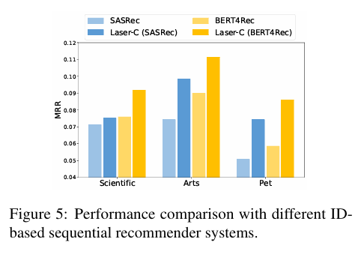
ATAI
Advanced Technique of Artificial Intelligence
ATAI
ChongqingUniversity _{AdvancedTechniqueof}
of Technology Artificial Intelligence
Chongqing University of
Technology
Chongqing University ^{ATAI}
_{of Technology} Advanced Techniqueof
Artificial Intelligence
Chongqing University of Technology
Chongqing University of Technology

Slide 14
ATAI
Advanced Technique of Artificial Intelligence
ATAI
ChongqingUniversity _{AdvancedTechniqueof}
of Technology Artificial Intelligence
Chongqing University of
Technology
Chongqing University ^{ATAI}
_{of Technology} Advanced Techniqueof
Artificial Intelligence
Chongqing University of Technology
Chongqing University of Technology
Thanks!

